Slide 1


“ Professional medical equipment, medical supplies,
medical furniture and speciality (branded and non branded) medicines

Slide 2


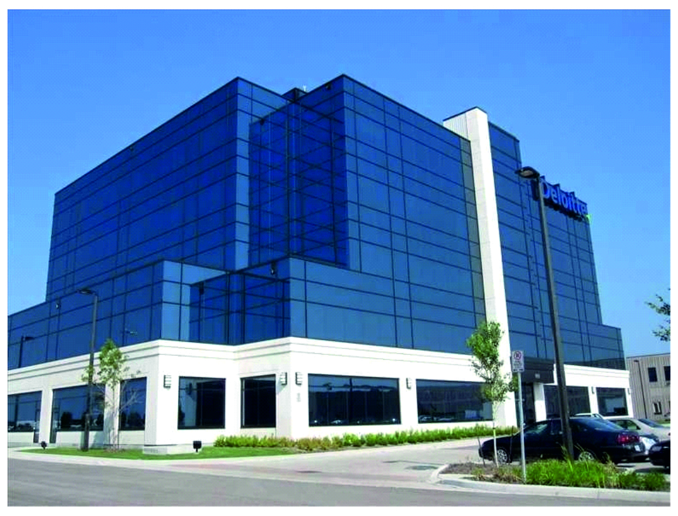
eMedeCare Inc is a Canadian based company with over 8000 certified Professional Medical Products (Medical equipment, Medical Supplies, Medical furniture) and over 5000 Pharmaceutical's (Branded, Non Branded, and Specialty Medications). We now have Exclusivity to sell EV and regular Ambulances on Caribbean Islands

Slide 3
We have an added advantage of being one of the best
"ONE STOP SHOP". with competitive pricing. One PO, One invoice, One commercial document, One shipment and One customs clearance. Our Pharmaceutical products comes from India, Our Professional Medical Equipment come from Europe,
China and India. We have an active presence in most of the
islands namely:
Cayman Islands , St. Lucia Jamaica Barbados Belize Antigua … and many more.
Our satisfied customers now have more confidence and peace of mind knowing their orders are to and from a respectful and trusted company. We now a "ONE STOP SHOP" to our customers for their pharmaceutical product needs. We have our pharma presence in some of the islands and expanding. All Our pharmaceutical products are stocked in our India office and are ready to ship as per the customer needs. We have tie up with best in industry like (WHO, GMP and ISO) certified Manufacturers for pharma formulations.

Slide 4


We aspire to deliver high quality, safe and effective professional medical product and pharmaceutical products & services that fulfil expectation across the globe, competent workforce and better inventions in medicines & stronger collaboration worldwide.

Slide 5

WHAT WE SUPPLY
Medical Equipment
Medical Supplies
Medical Furniture
EV Ambulances
Speciality Branded and Generic Medications

Slide 6

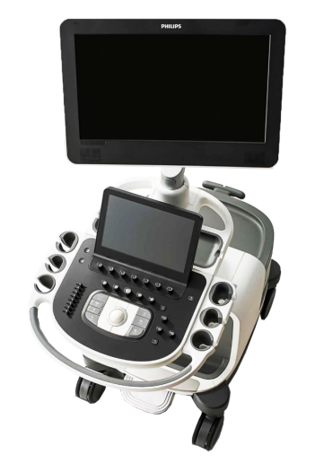
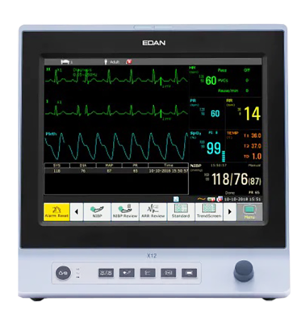
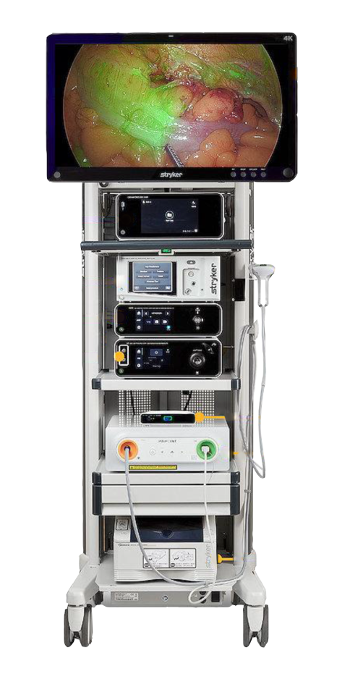
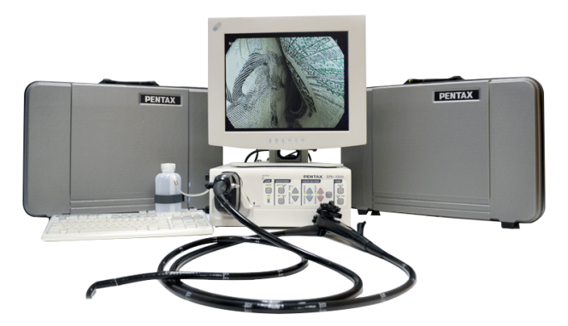
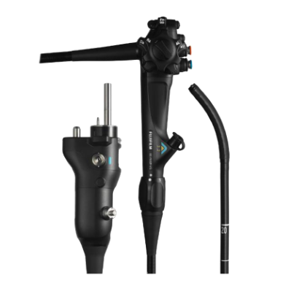
Medical Equipment & Medicines
MEDICAL EQUIPMENT

Slide 7
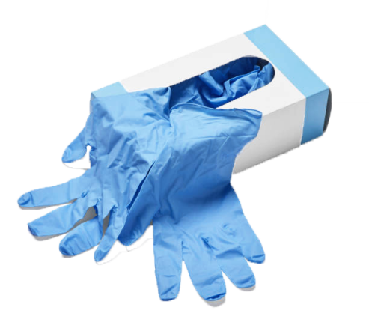

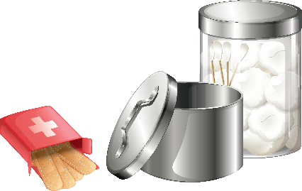
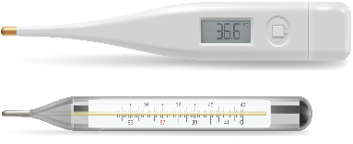
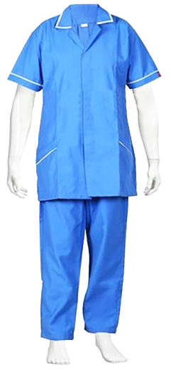
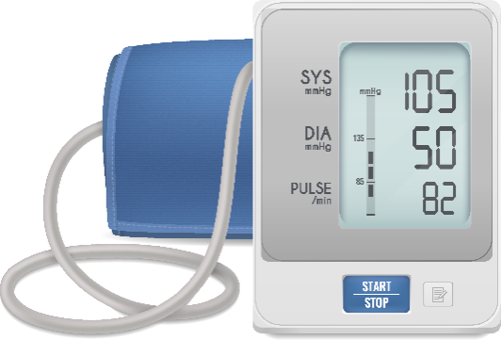
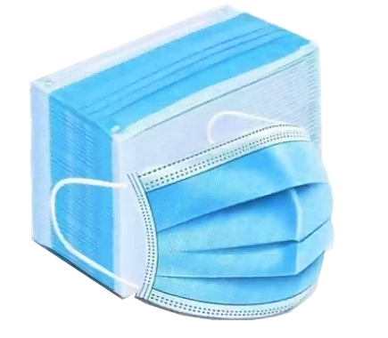
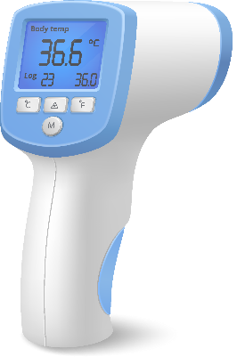
Medical Equipment & Medicines
MEDICAL SUPPLIES

Slide 8
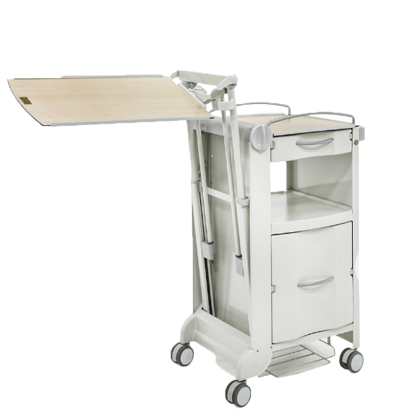
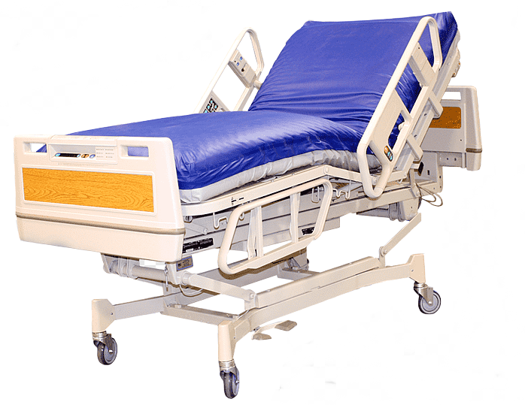
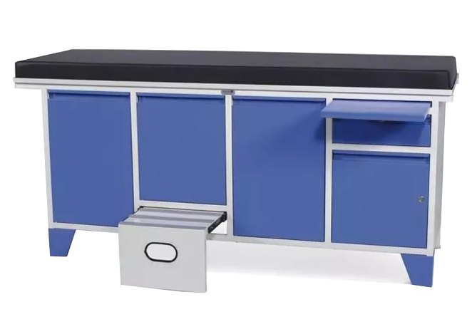
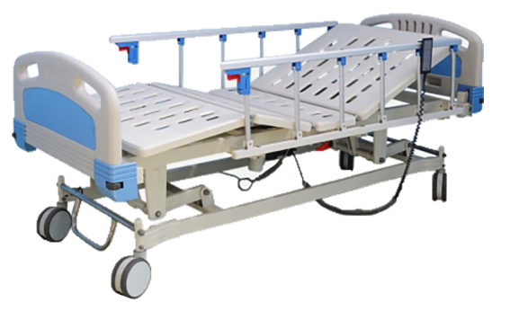
Medical Equipment & Medicines
MEDICAL FURNITURE

Slide 9
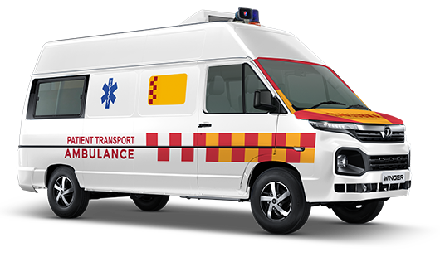
Medical Equipment & Medicines
EV AMBULANCES

Slide 10
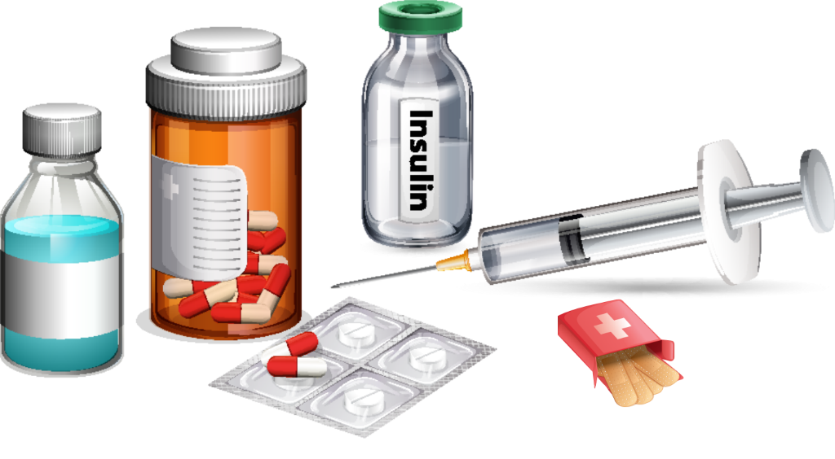

Medical Equipment & Medicines
SPECIALITY BRANDED & GENERIC MEDICATIONS

Slide 11

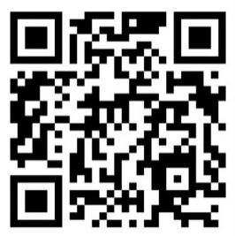
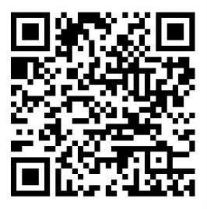

OUR BRANDS
CONTACT DETAILS
EMED catalogue
Ambulances
info@emedecare.com
647-448-2445 (what's app)
617-933-9932
416-275-9257

